Slide 1

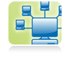




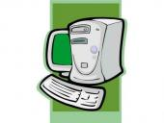




Green IT
GREEN IT

Slide 2

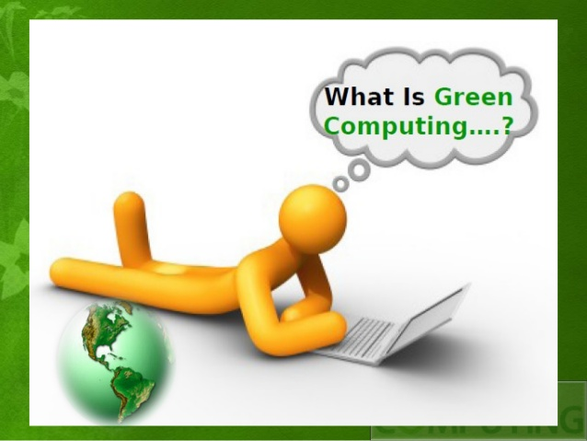

Slide 3
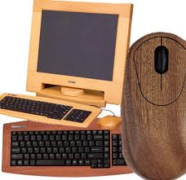

GREEN IT or GREEN COmputing
San Murugesan states that green IT is the study and practice of "designing, manufacturing, using, and disposing of computers, servers, and associated subsystems—such as monitors, printers, storage devices, and networking and communications systems — efficiently, economically and effectively with minimal or no impact on the environment

Slide 4
OBJECTIVES OF GREEN IT
Enable sustainable IT growth.
Maximize energy efficiency during product’s life time.
Promote recyclability and biodegradability of defunct products and factory wastes.
Reduce the amount of hazardous materials used
Deliver better customer value.

Slide 5

ORIGIN
One of the first manifestations of the green computing movement was the launch of energy star program back in 1992.
Energy Star served as a kind of voluntary label awarded to computing products that succeeded in minimizing use of energy while maximizing efficiency.
Energy Star applied to products like computer monitors, television sets and temperature control devices like refrigerators, air conditioners, and similar items.

Slide 6
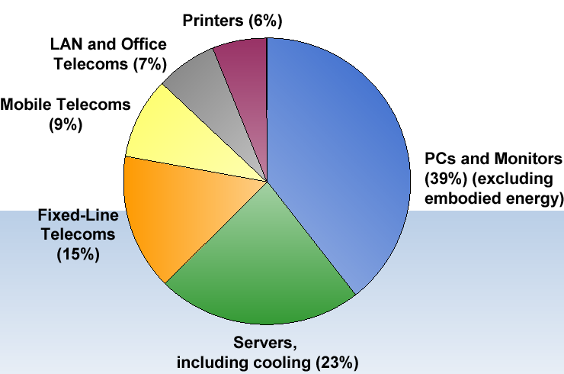
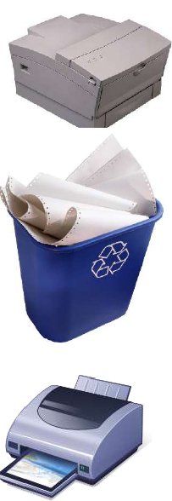
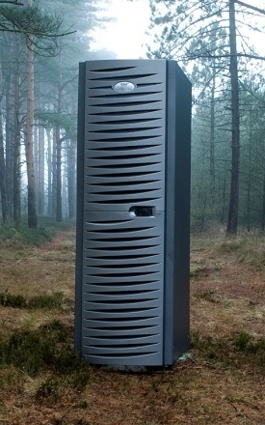
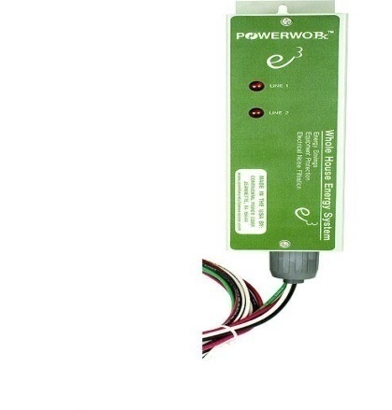
ICT'S Global Carbon Dioxide Emissions
Information and Communication Technology

Slide 7
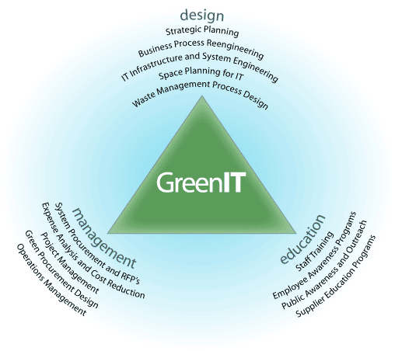
ROAD TO GREEN IT
Green Use
Green Disposal
Green Design
Green Manufacturing

Slide 8
ACTION PLANS
Initiative by Apple:
MacBook keyboards are made from one single piece of aluminum
MacBook pro notebooks have long lasting batteries where as a normal notebook uses three batteries. MacBook will only use one through out its life time.
Initiatives by DELL:
Their free world-wide product recycling program allows user to properly dispose their product safely.
Their “Plant a tree for me” project can offset a customers carbon emissions for only three dollars.
Initiatives by IBM:
Provides services on the Lean Six Sigma principles of efficiency.
This consulting service is aimed at examining use of energy and water and subsequently providing the control measures to conserve energy.
IBM in 2010 saved around 14.6 billion kWh of electricity and prevented almost 12 million metric tones of CO2 emissions.

Slide 9
ACTION PLANS
Initiative by VMware:
It is the global leader in virtualization solutions from the desktop through the datacenter and to the cloud.
Throughout its design and buildout, VMware chose industry best practices to create an energy-efficient facility that utilizes cutting-edge technology and maximizes the use of VMware virtualization software.

Slide 10











COMPANIES GOING GREEN…

Slide 11

Approaches to green IT
Product longevity
Algorithmic efficiency
Resource allocation
Virtualization
Terminal servers
Power management
Operating system support
Power supply
Storage
Video card
Display
Materials recycling
Cloud Computing
Disposal of electronic waste

Slide 12

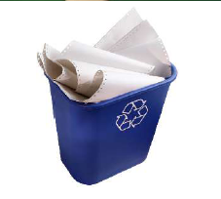
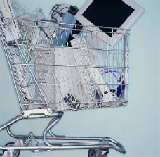
Techniques to enable Green IT
Reduce
Reuse
Recycle
Consume fewer servers, printers, etc by increasing utilization by - virtualization cloud computing.
Stop over provisioning; improve capacity planning.
Turn power management on.
Extend the life of assets by reusing them within the enterprise and externally.
Ensure and validate the correct disposition of all electronic equipment.
Buy recyclable products.

Slide 13
Techniques and Technologies
Virtualization:
In computing, virtualization refers to the act of creating a virtual (rather than actual) version of something, including virtual computer hardware platforms, operating systems, storage devices, and computer network resources.
It includes Server virtualization, Consolidation, Storage consolidation & Desktop virtualization.
Using Thin Clients, each employee has a virtual desktop that includes a mouse, keyboard and screen while the remaining unit is shared by all at a central location.
Our typical computer used up to a 250-watt power supply; our thin client uses a 4.8-watt power supply.

Slide 14




Optimize IT Energy use
Managing Power Wisely
High Availability and Virtualization
Protecting and Backing up Data
Designing Efficient Data Centers

Slide 15
Techniques and Technologies
Power management:
Prolong battery life.
Reduce cooling requirements.
Reduce noise.
Reduce operating costs for energy and cooling.
Lower power consumption.
The ACPI, an open industry standard
Under volting programs

Slide 16
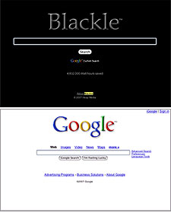
Techniques and Technologies
BLACKLE:
A search-engine site powered by Google Search.
Based on the concept that : When presenting an empty word page or the Google home page, If a computer screen is :
White it consumes 74W
Black it consumes only 59W.
switching from Google to Blackle :
Earth would save 750MW/ yr.

Slide 17
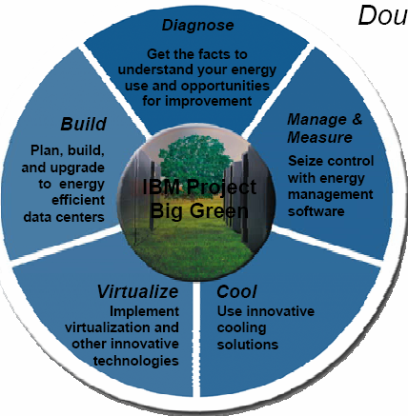
Five building blocks provide the tools to operational savings and business growth. SUSTAINABILITY
ms
sm
Double your IT capacity
In the same energy footprint
Reduce operational costs
40-50% energy savings
Positive environmental
Impact
1,300 less cars or 3.5M
less pounds of coal

Slide 18
Techniques &Technologies
Storage:
Among 3.5" desktop hard drive, 2.5" laptop hard drive and a solid state hard drive.
SSD consumes less power than other disks.
Display:
LCD displays: use a CCF bulb
LED displays: use an array of LEDs
LCD monitors uses 3 times less when active, and 10 times less energy when in sleep mode.
LCDs are up to 66% more energy efficient.
LCDs are also smaller in size and weight.
21" CRT typically uses more than 120W.

Slide 19
Techniques &Technologies
Algorithmic efficiency:
The Efficiency of algorithms is used to describe properties of an algorithm relating to how much resources it consumes.
Algorithms are the base of any computing system or electronic device, each and every computer chip has a certain algorithm that allows it to complete its function.
Even though these chips are small, they use a lot of power.

Slide 20
Techniques &Technologies
Operating System Support:
Windows 7 includes refinements for more efficient user of operating system timers, processor power management, and display panel brightness.
Linux Os utilizing less resources than other os, and also have a better power management facility.
Terminal servers:
Terminals can be combined with thin clients, which use up to 1/8 the amount of energy of a normal workstation.

Slide 21
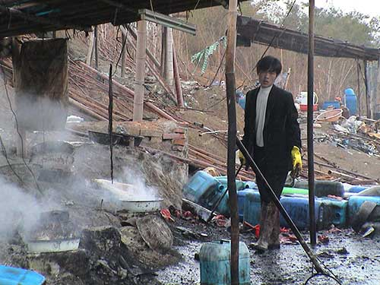
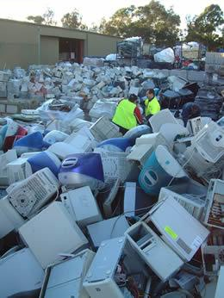
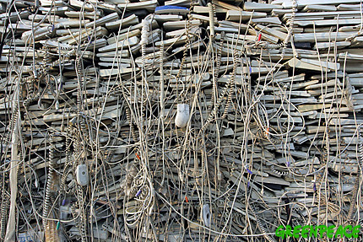
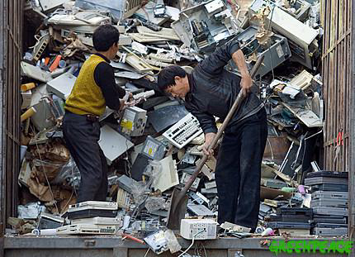
E WASTE DISPOSAL
Electronic waste or E-waste is loosely discarded, surplus, obsolete or broken electrical or electronic devices.
E-waste is due of improper practice of disposing computer and its components.
E-waste management includes recycling, consumer awareness efforts, processing techniques, also tells us benefits of recycling.
Elements in bulk: lead, tin, copper, silicon, carbon, iron and aluminum Elements in small amounts: cadmium and mercury. Examples of devices containing these elements:almost all electronics contain lead & tin (as solder) and copper (as wire & PCB tracks), though the use of lead-free solder is now spreading rapidly lead: solder, CRT monitors (Lead in glass), Lead-acid battery

Slide 22

Techniques &Technologies
Explore Alternative Sources of Energy
The efficient resource utilization leads towards efficient methods to evolve. With time renewable and natural energy sources are being used to power data centers, such as nuclear or hydroelectric power, solar energy etc. This saves money and generates fewer CO2 emissions.

Slide 23

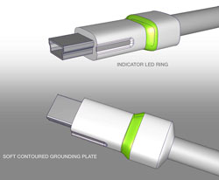

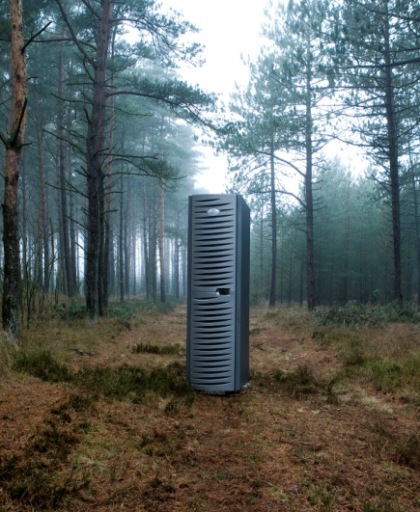
Greening the Users..
Save energy by encouraging staff to power down their equipment when not in use.
Embrace virtualization technologies (using IT environments more efficiently) and explore the consolidation of data processing and storage.
Dispose of your technologies in a sound and environmentally friendly manner, and
Utilize technologies that allow staff to stay connected in remote locations, participate in meetings without travel, and respond quickly during emergency situations.

Slide 24
Simple Tasks we can do !
Buy and use a low power desktop or a laptop computer (40-90 watts) rather a higher power desktop (e.g. 300 watts).
Thin clients can use only 4 to 8 watts of power at the desktop as the processing is done by a server.
Buy hardware from manufacturers that have a hardware recycling scheme, and recycle your old computer equipment rather than sending it to landfill.
Use distributed servers instead of rack or standalone servers to reduce power consumption.
Turn your computer and monitor off when you are not using it.
Use Linux (such as Ubuntu), which requires less resources than many other operating systems on an older computer as a spare or a file server.
Enable hibernation using the power management settings. Standby does not save as much power.
Replace your CRT screen with an LCD screen.
Save Your Paper!
Green Print Saves Too!

